Slide 1




CORONA VIRUS
Analysis Using SQL

Slide 2


Overview:
It is our responsibility as data analysts to examine COVID-19 data and determine what it reveals. We play the role of detectives, but rather than concentrating on cracking cases, we try to figure out how the virus infects people. We can help make well-informed decisions to manage the pandemic and safeguard public health by looking at the data and trends.

Slide 3

Dataset Information:
Description of each column in dataset:
Province: Geographic subdivision within a country/region.
Country/Region: Geographic entity where data is recorded.
Latitude: North-south position on Earth's surface.
Longitude: East-west position on Earth's surface.
Date: Recorded date of CORONA VIRUS data.
Confirmed: Number of diagnosed CORONA VIRUS cases.
Deaths: Number of CORONA VIRUS related deaths.
Recovered: Number of recovered CORONA VIRUS cases.

Slide 4
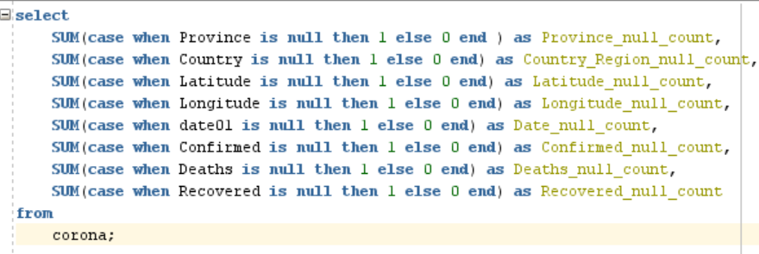
Q1 . Write a code to check NULL values
.

Slide 5

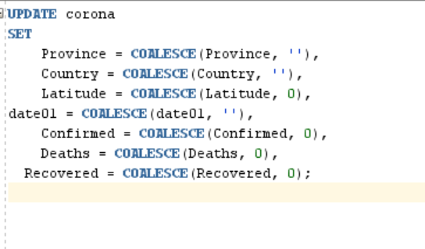

Q2. If NULL values are present, update them with zeros for all columns.

Slide 6





Q3. check total number of rows

Slide 7


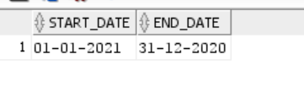
Q4. Check what is start_date and end_date

Slide 8
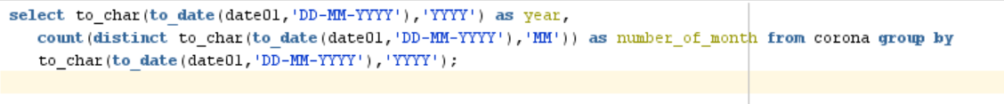

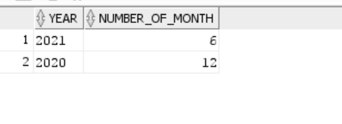
Q5. Number of month present in dataset

Slide 9

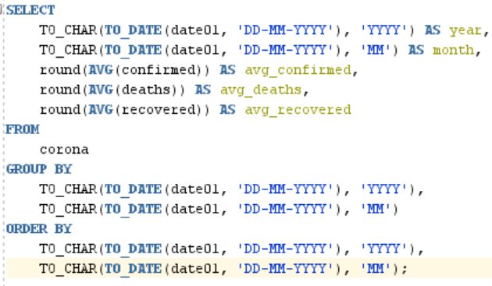
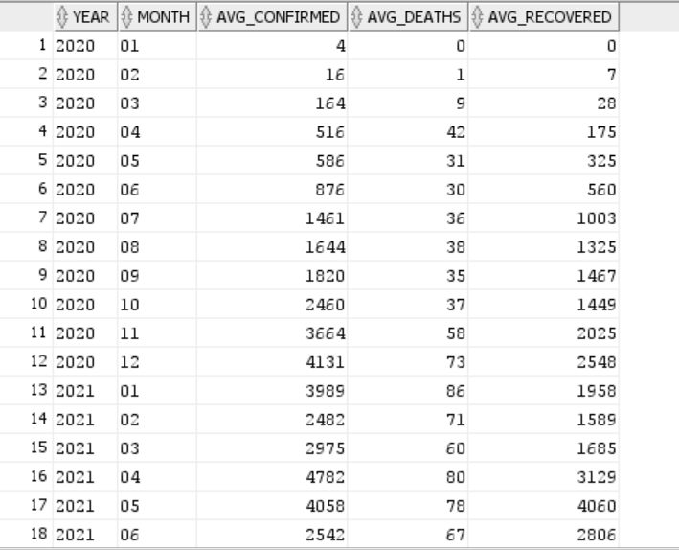
Q6. Find monthly average for confirmed, deaths, recovered

Slide 10
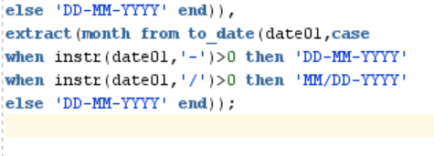
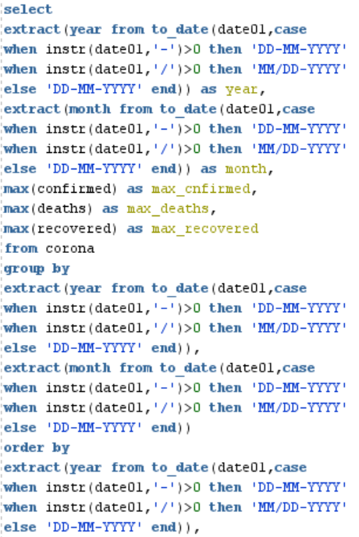
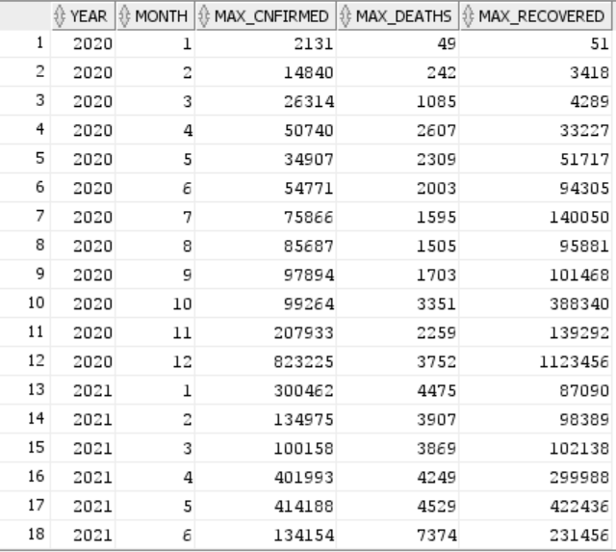
Q7. Find most frequent value for confirmed, deaths, recovered each month

Slide 11
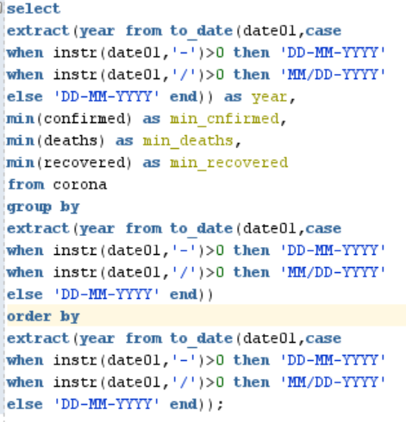
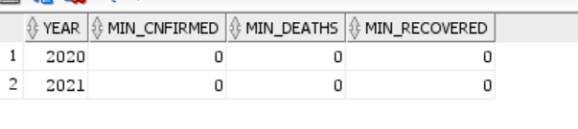
Q8Find minimum values for confirmed, deaths, recovered per year

Slide 12
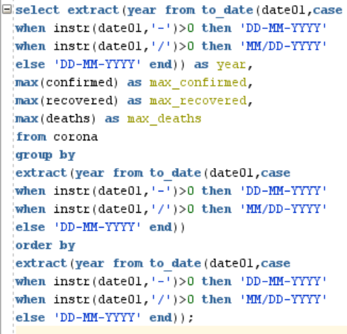
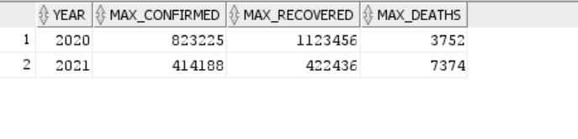
Q9:Find maximum values of confirmed, deaths, recovered per year

Slide 13
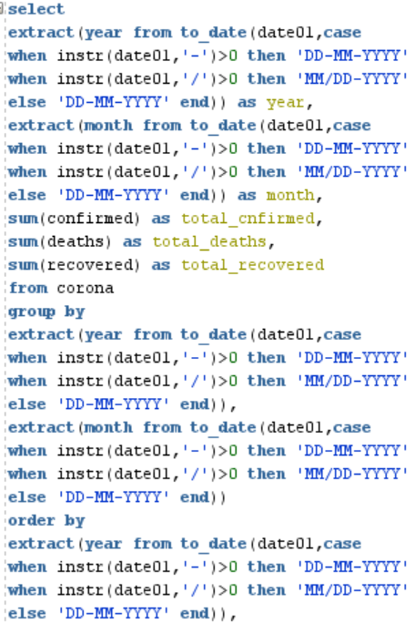
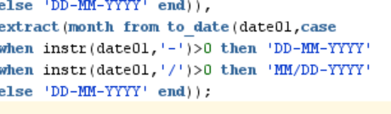
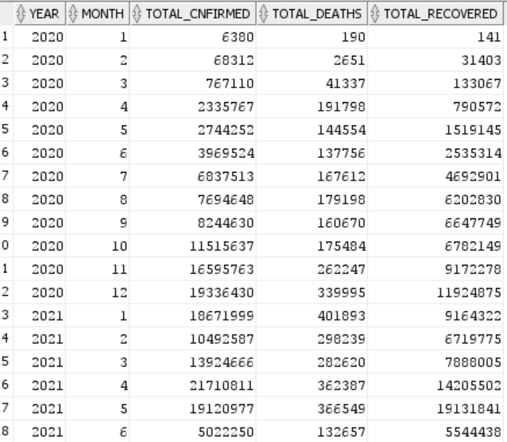
Q10. The total number of case of confirmed, deaths, recovered each month

Slide 14
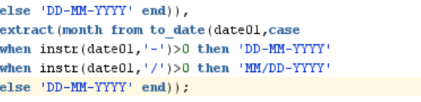
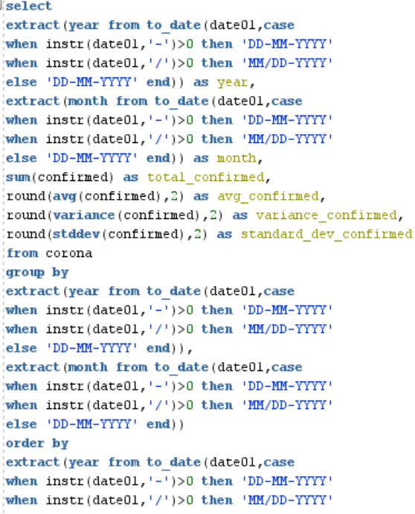
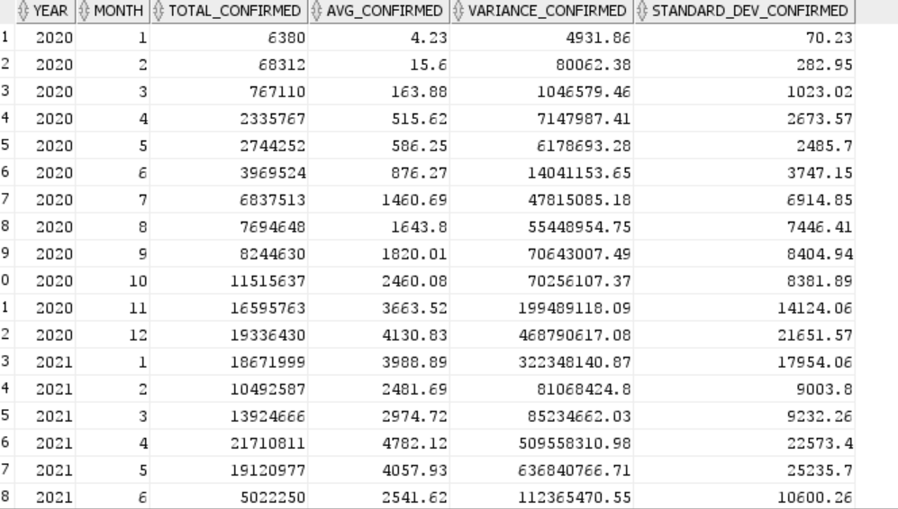
Q11:Check how corona virus spread out with respect to confirmed case
S

Slide 15
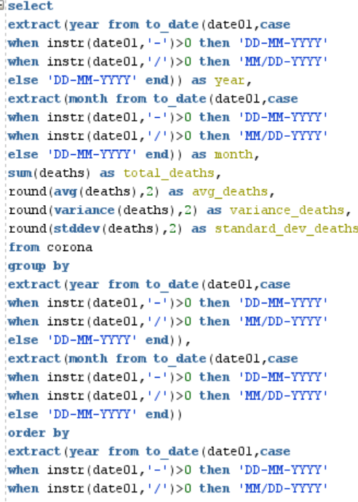
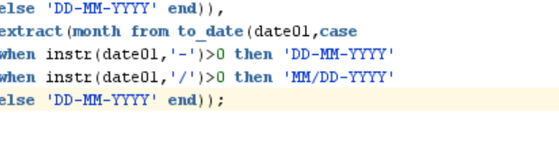
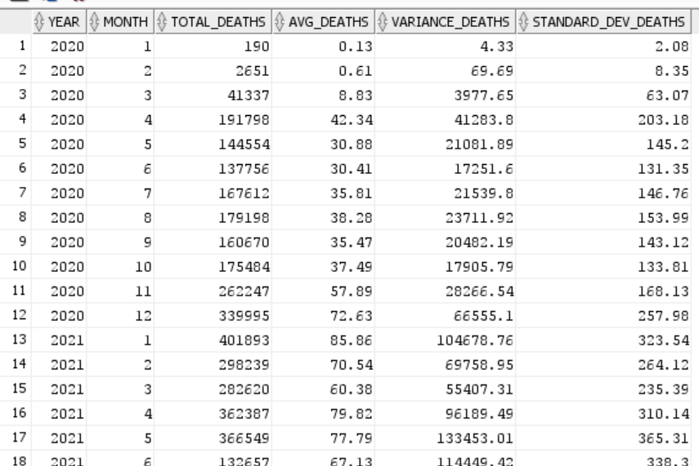
Q12. Check how corona virus spread out with respect to death case per month

Slide 16
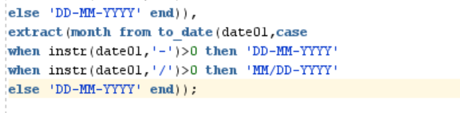
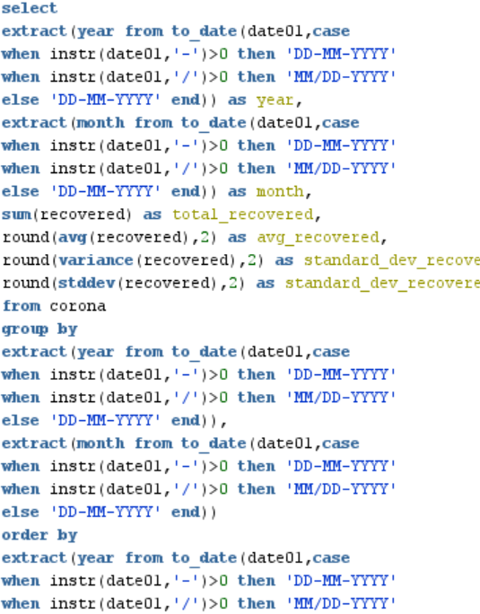
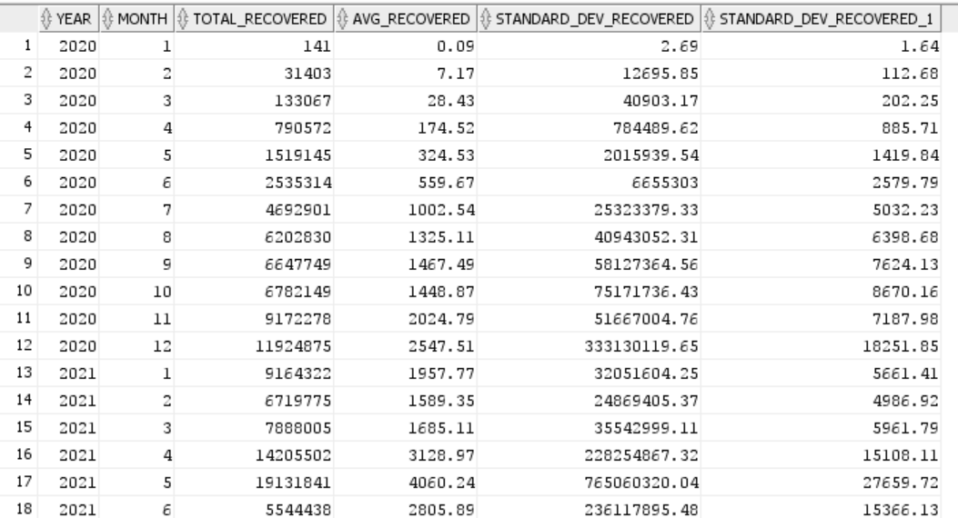
Q:13 Check how corona virus spread out with respect to recovered case
S

Slide 17
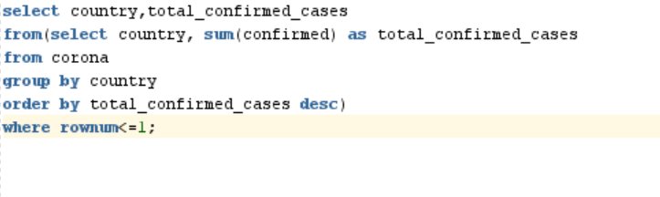
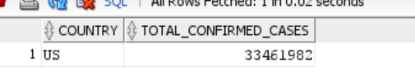
Q14. Find Country having highest number of the Confirmed case

Slide 18

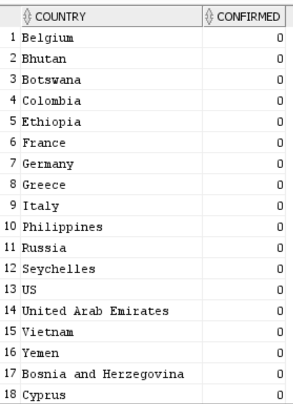
Q15. Find Country having lowest number of the death case
S

Slide 19
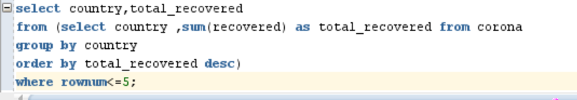
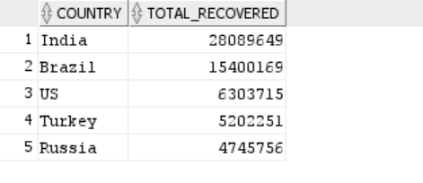
Q16. Find top 5 countries having highest recovered case

